Slide 1
Image Caption Generator
By
Eng/ Mohamed Yosri
As a Final Project for AI Diploma Given by: Array Academy

Slide 2
Contents:
1- Introduction
2- Applications for Image Processing, NLP
3- Principle of Image Caption Generator
4- Development of an Image Caption Generator
5- Pseudocode of the developed Image Caption Generator
6- Code of the developed Image Caption Generator
7- Streamlit Application Deployment
8- Final Product and Conclusion

Slide 3
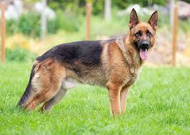
Introduction
Image
Caption that describes the image as accurate as possible
German Shepherd standing on grass

Slide 4
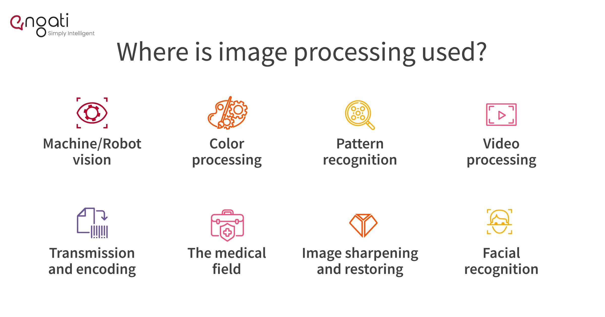
Applications for Image Processing, NLP

Slide 5
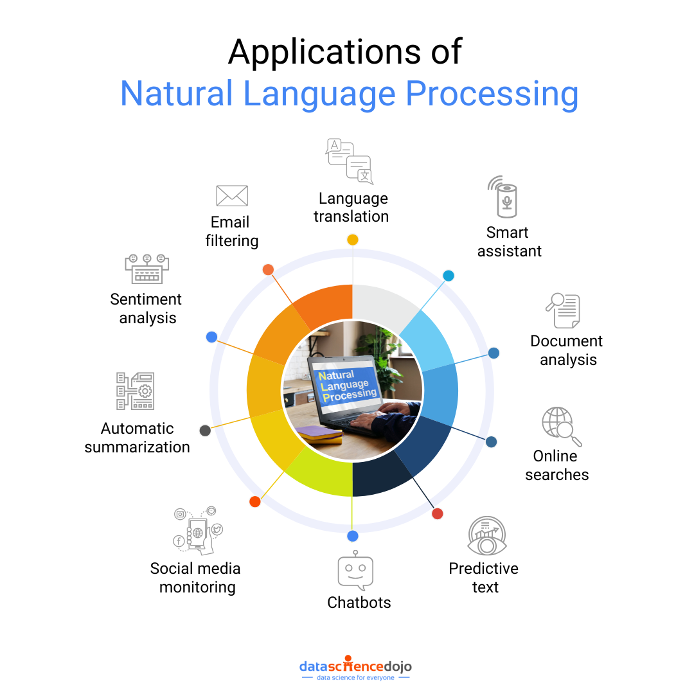
Applications for Image Processing, NLP

Slide 6
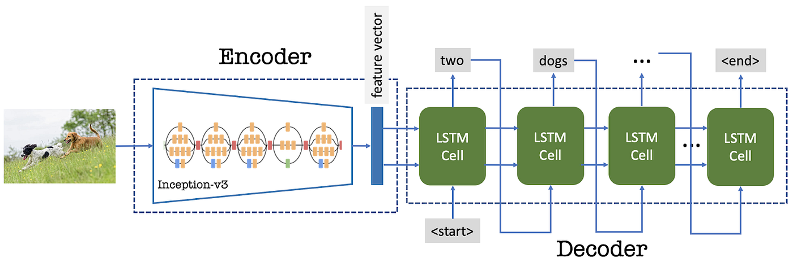
Principle of Image Caption Generator

Slide 7
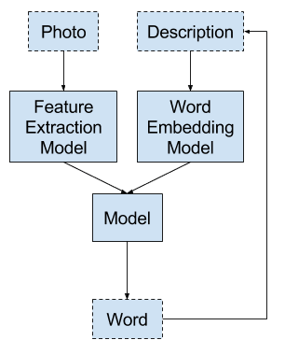
Development of an Image Caption Generator
7

Slide 8
1. Load Captions from File
o Initialize an empty dictionary captions.
o Open the file and read each line.
o Strip whitespace from the line.
o If the line is empty, continue to the next.
o Split the line into image_id and caption using a tab (\t).
o Extract the image_id by splitting at # to remove numbering.
o Convert caption to lowercase and remove punctuation.
o Store the caption in captions dictionary under image_id.
o Return the captions dictionary.
Pseudocode of the developed Image Caption Generator
2. Extract Image Features Using Pre-trained Model
o Initialize an empty dictionary features.
o Loop through all image files in the given directory.
o Check if the file extension is .jpg, .jpeg, or .png.
o Construct full image path.
o Load the image and resize it to 224x224.
o Convert the image to an array and expand dimensions.
o Preprocess the image using the specified function.
o Pass the image through the model to extract features.
o Store the extracted feature in the features dictionary.
o Return the features dictionary.

Slide 9
3. Load Pre-trained VGG16 Model
o Load VGG16 model with pre-trained weights.
o Modify the model to output feature vectors instead of classification.
4. Extract and Save Features
o Extract features from images using VGG16.
o Save extracted features to a pickle file.
o Download the saved file.
Pseudocode of the developed Image Caption Generator
5. Load and Tokenize Captions
o Load captions from the dataset file.
o Initialize a tokenizer and fit it on the captions.
o Determine vocabulary size.
o Compute the maximum caption length.
6. Load Extracted Features
o Open and load the saved features from the pickle file.
o Store features in features_dict.
o Print available feature keys for debugging

Slide 10
7. Create Training Sequences
o Initialize empty lists X1, X2, and y.
o Loop through dataset_captions:
▪ Check if the image feature exists, else skip.
▪ Retrieve the feature vector for the image.
▪ Convert each caption to a sequence of numbers.
▪ Create input-output pairs by splitting the sequence.
▪ Pad sequences and one-hot encode output words.
▪ Append features and sequences to X1, X2, and y.
o Convert lists to NumPy arrays.
o Return X1, X2, and y.
Pseudocode of the developed Image Caption Generator
8. Build Captioning Model
o Define input layers for image features and text sequences.
o Add a Dense layer for feature transformation.
o Add an embedding layer for text processing.
o Use LSTM to process text sequences.
o Merge image and text features.
o Add Dense layers and output with softmax activation.
o Compile the model with categorical cross-entropy loss.
o Return the model.

Slide 11
9. Train Captioning Model
o Train the model using the generated training data.
o Print model summary.
10. Generate Captions for Images
o Define a function to remove repeated words from captions.
o Define generate_caption function:
▪ Start caption with "startseq".
▪ Generate words until max_length is reached.
▪ Convert sequence to text and append predicted words.
▪ Stop if "endseq" is generated.
▪ Return the cleaned caption.
Pseudocode of the developed Image Caption Generator
11. Extract Features from a New Image
o Load and preprocess the image.
o Extract features using the pre-trained model.
o Return the feature vector.
12. Test Caption Generator
o Extract features from a test image.
o Generate a caption using the trained model.
o Remove repeated words and unnecessary tokens.
o Display the image and print the generated caption.

Slide 12
Code of the developed Image Caption Generator

Slide 13
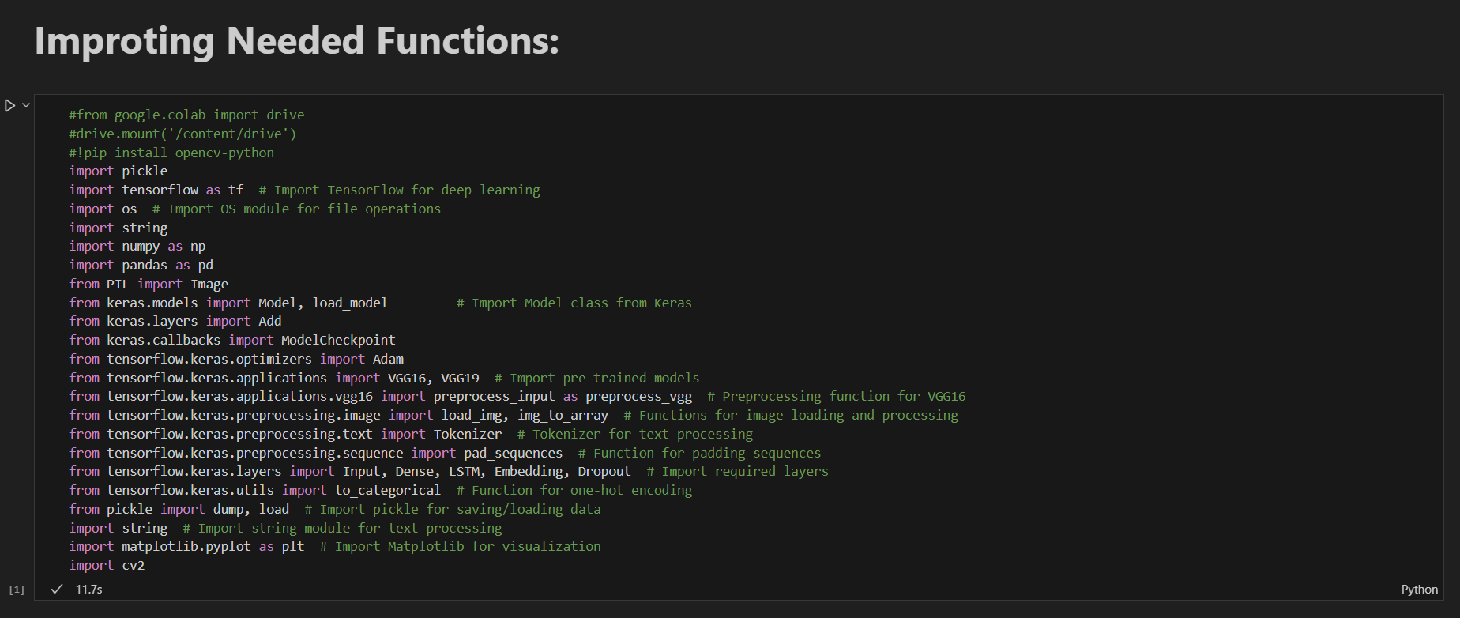

Slide 14
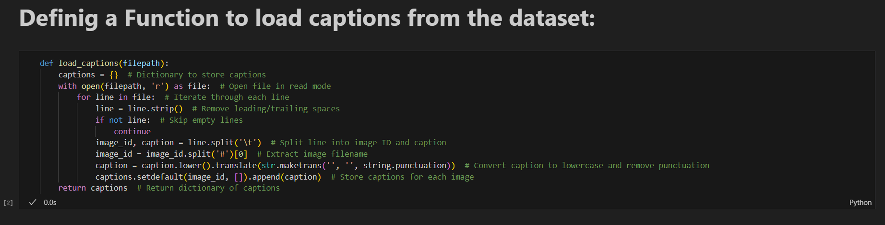
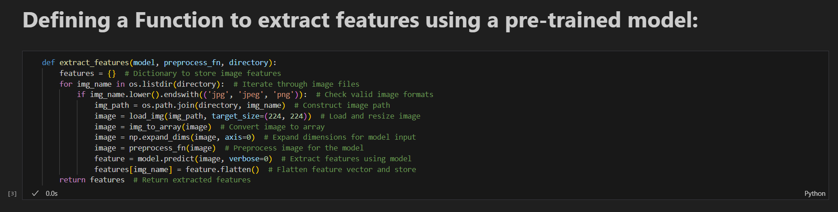

Slide 15
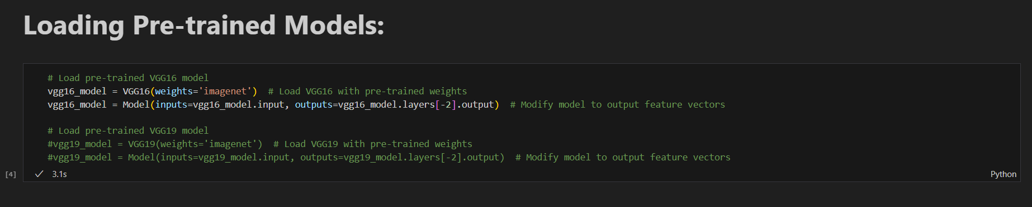
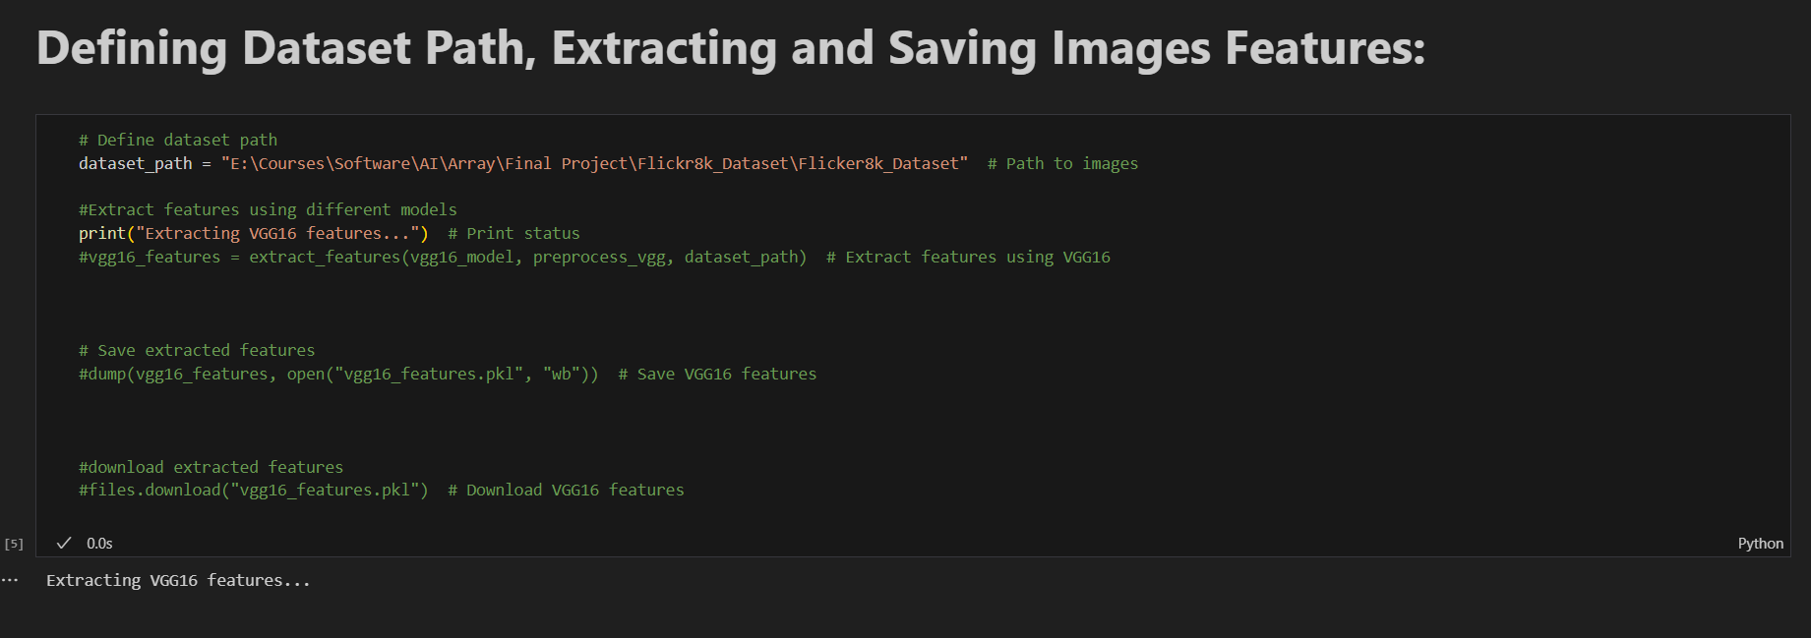

Slide 16
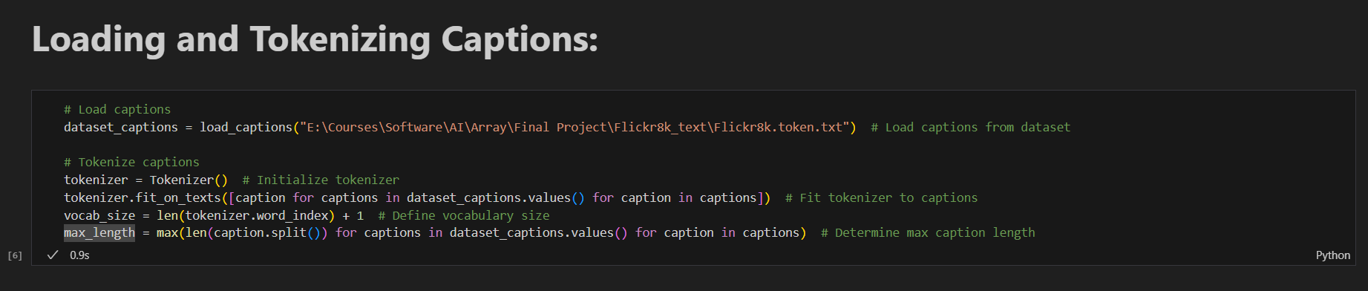
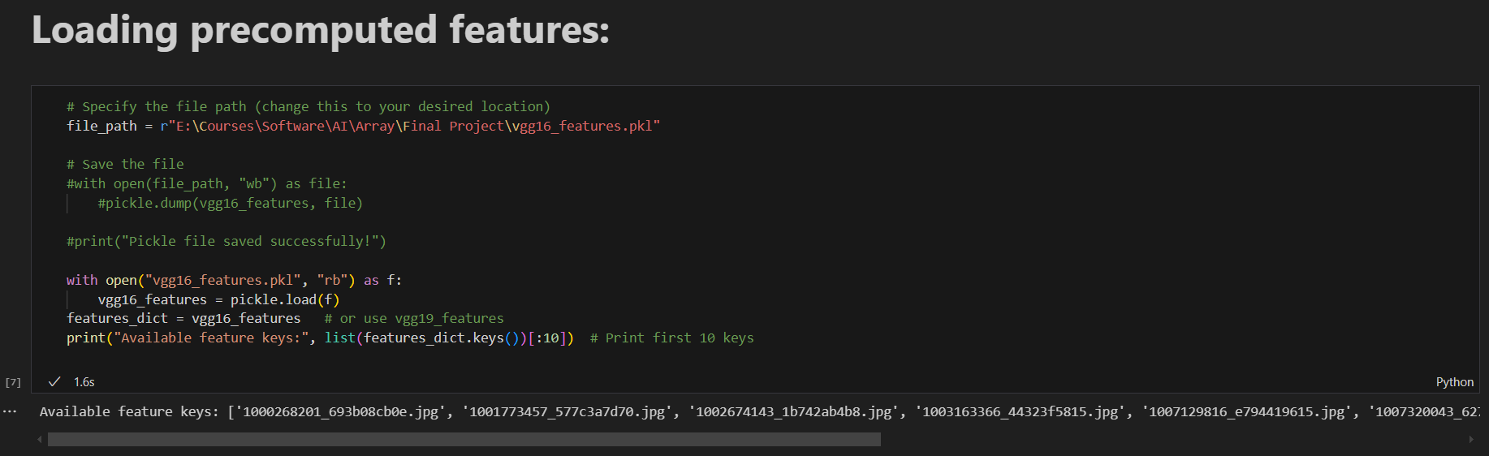

Slide 17
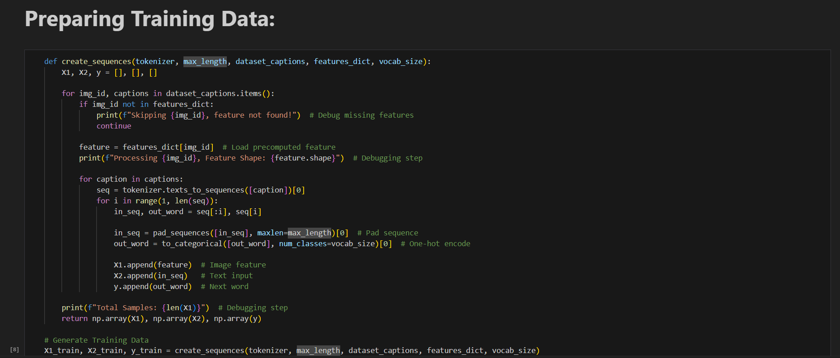

Slide 18
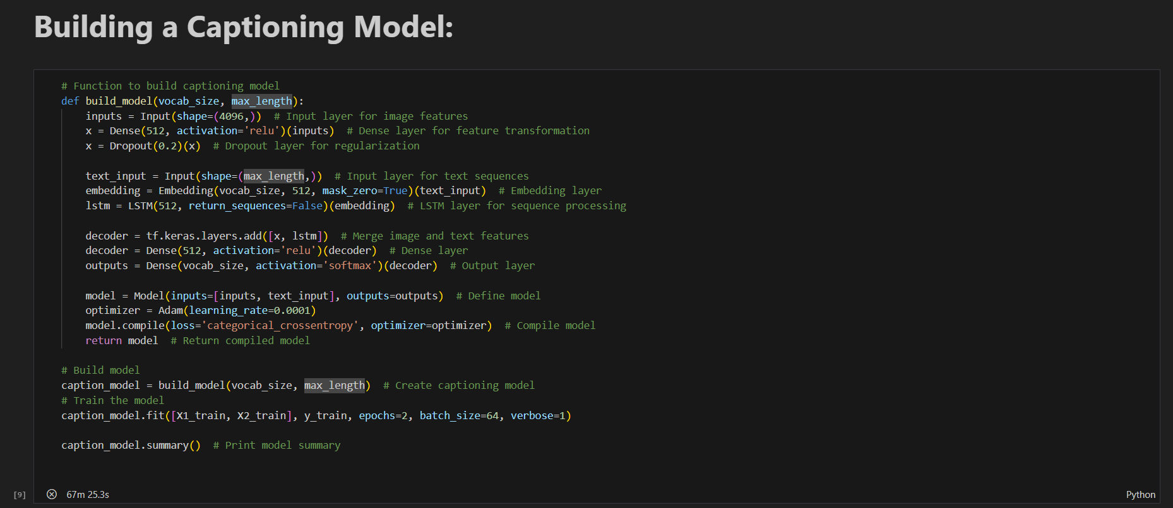

Slide 19
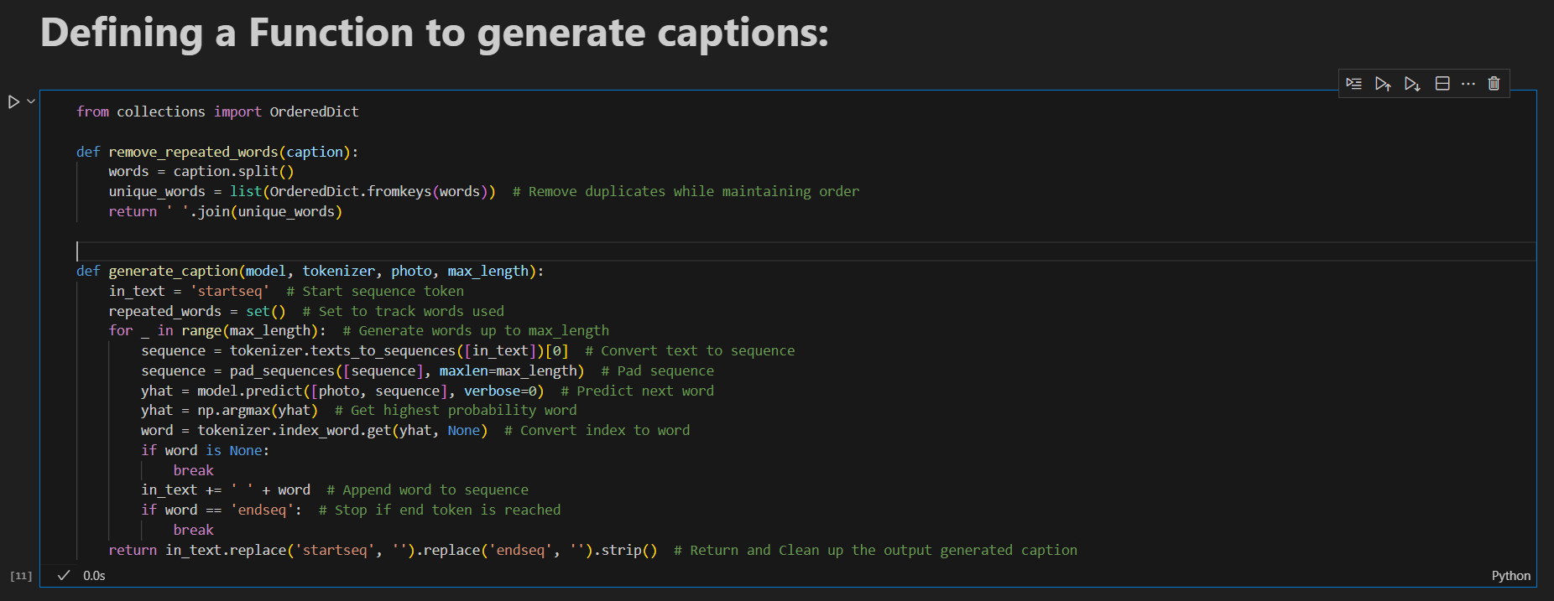
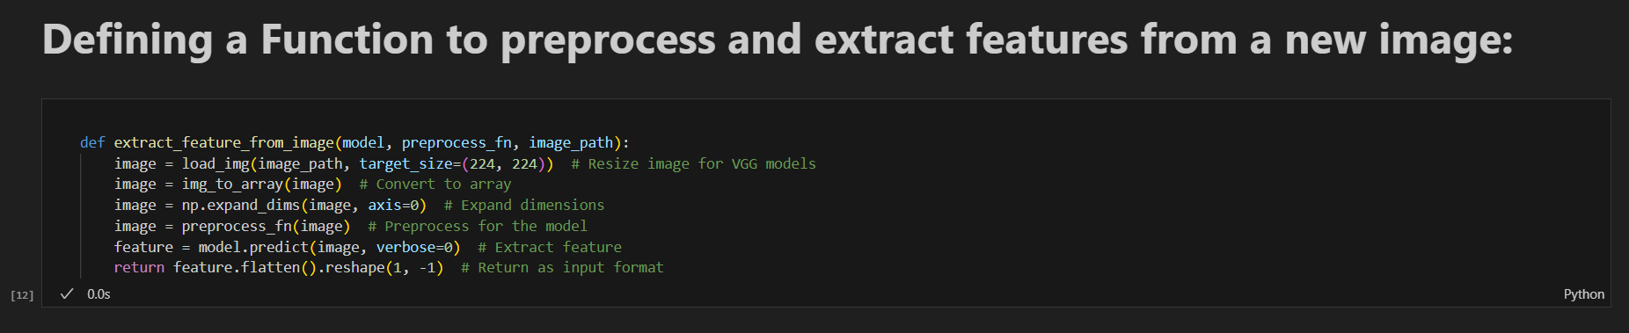

Slide 20
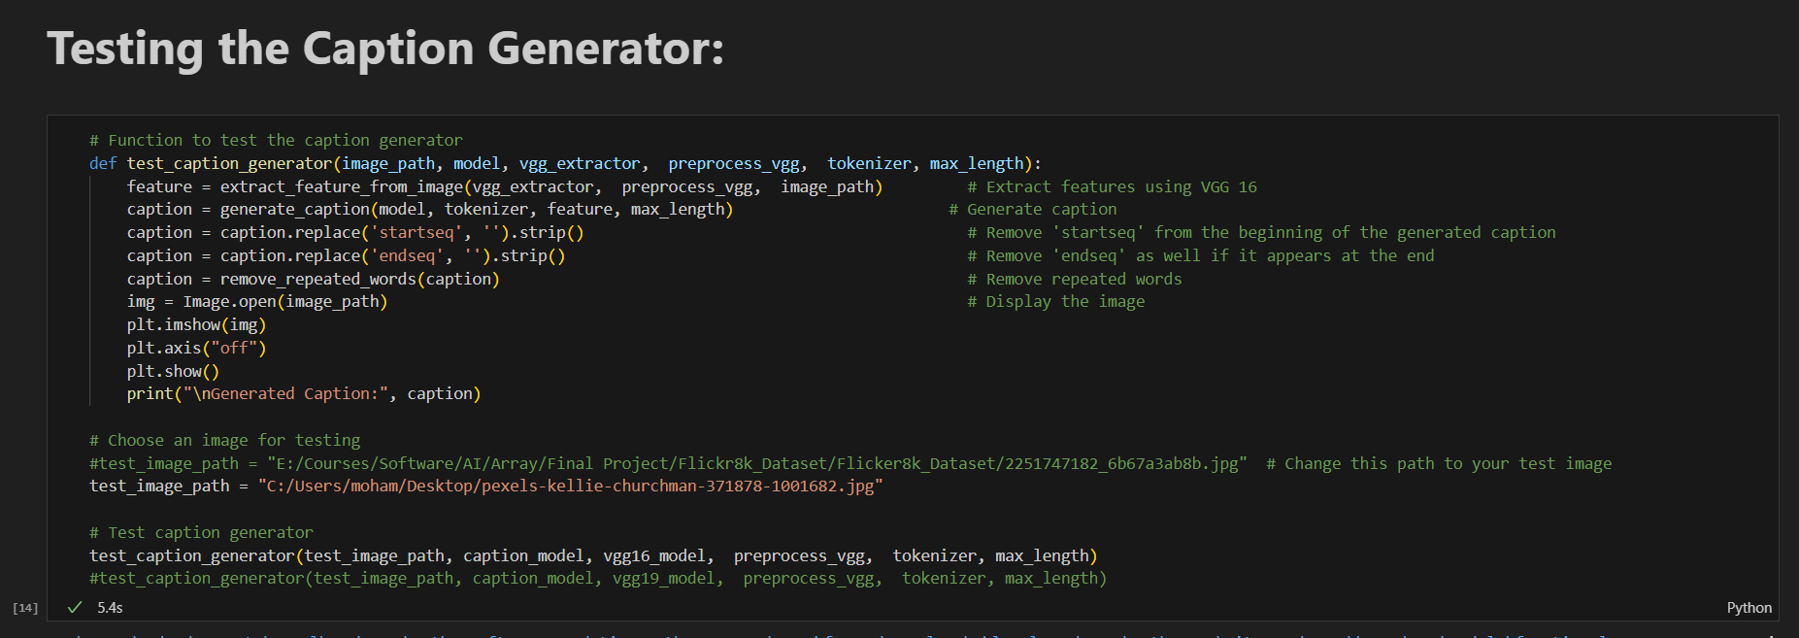

Slide 21
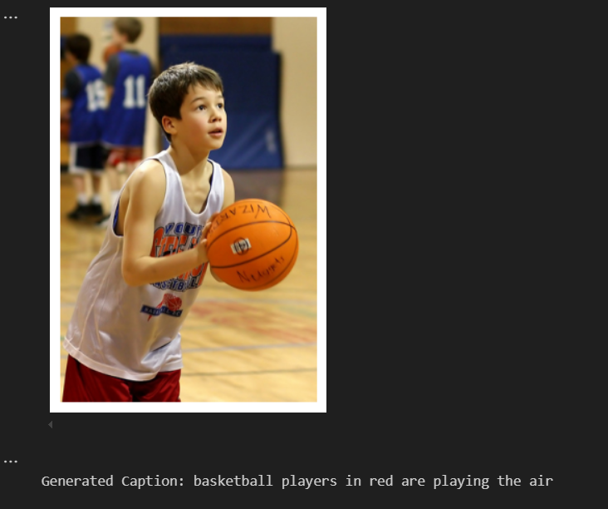
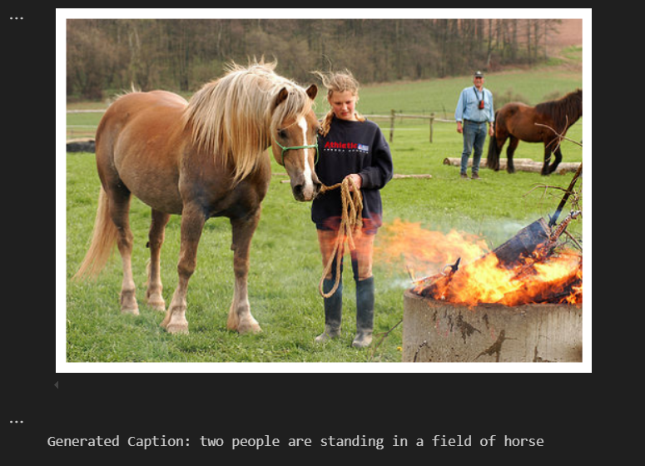
Testing with Images from the Flickr8k Dataset:

Slide 22
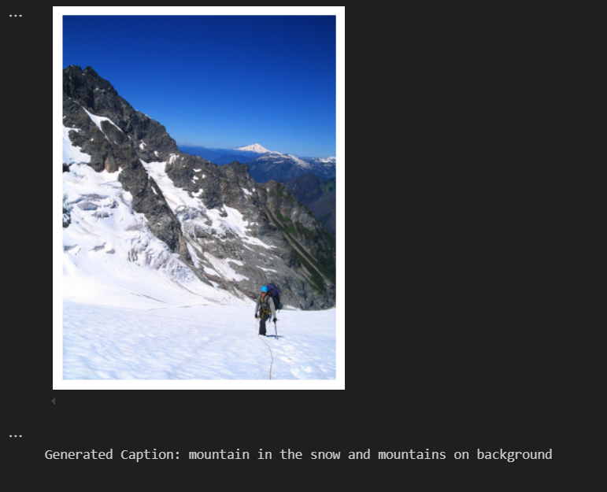
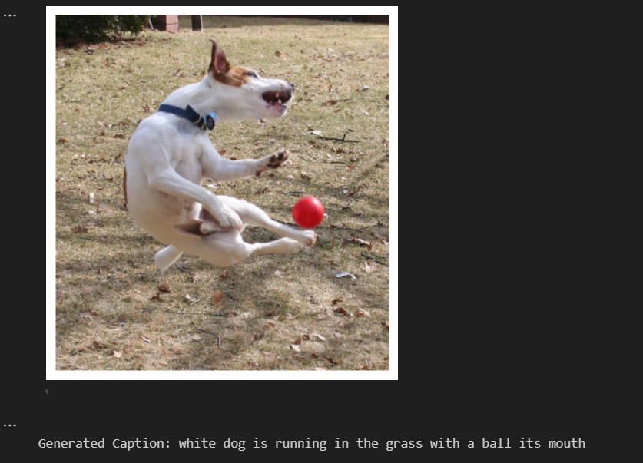
Testing with Images from the Flickr8k Dataset:

Slide 23
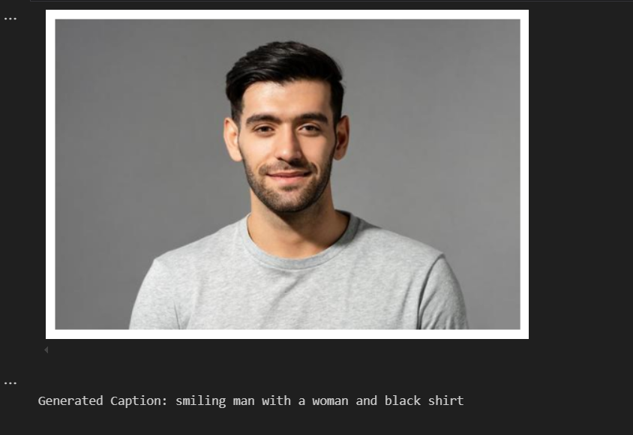
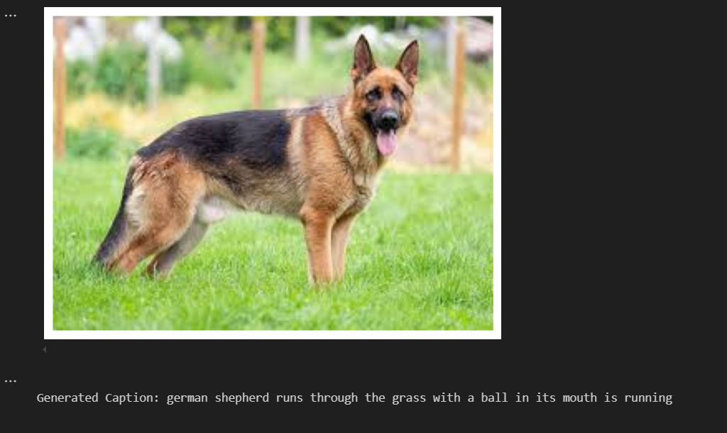
Testing with Images outside the Flickr8k Dataset (internet):

Slide 24
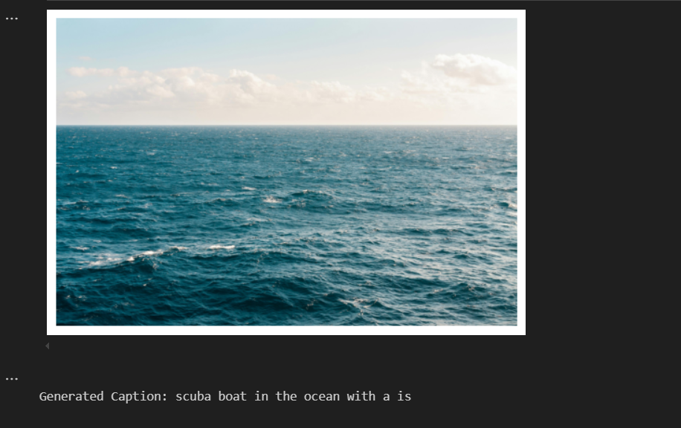
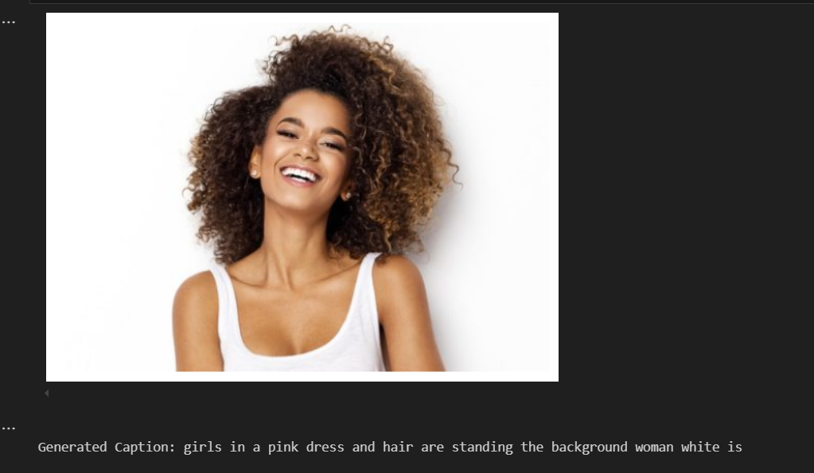
Testing with Images outside the Flickr8k Dataset (internet):

Slide 25
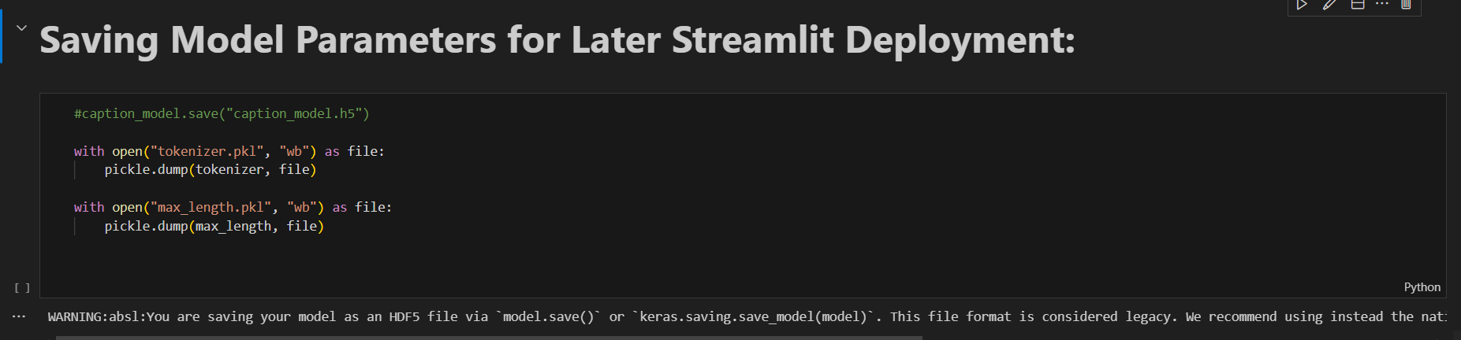
Streamlit Application Deployment

Slide 26
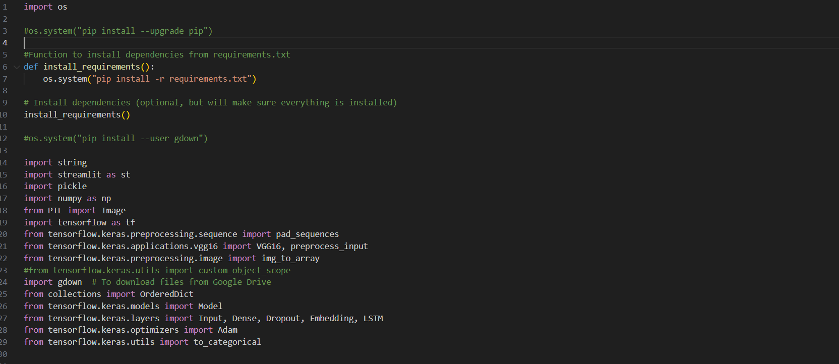

Slide 27
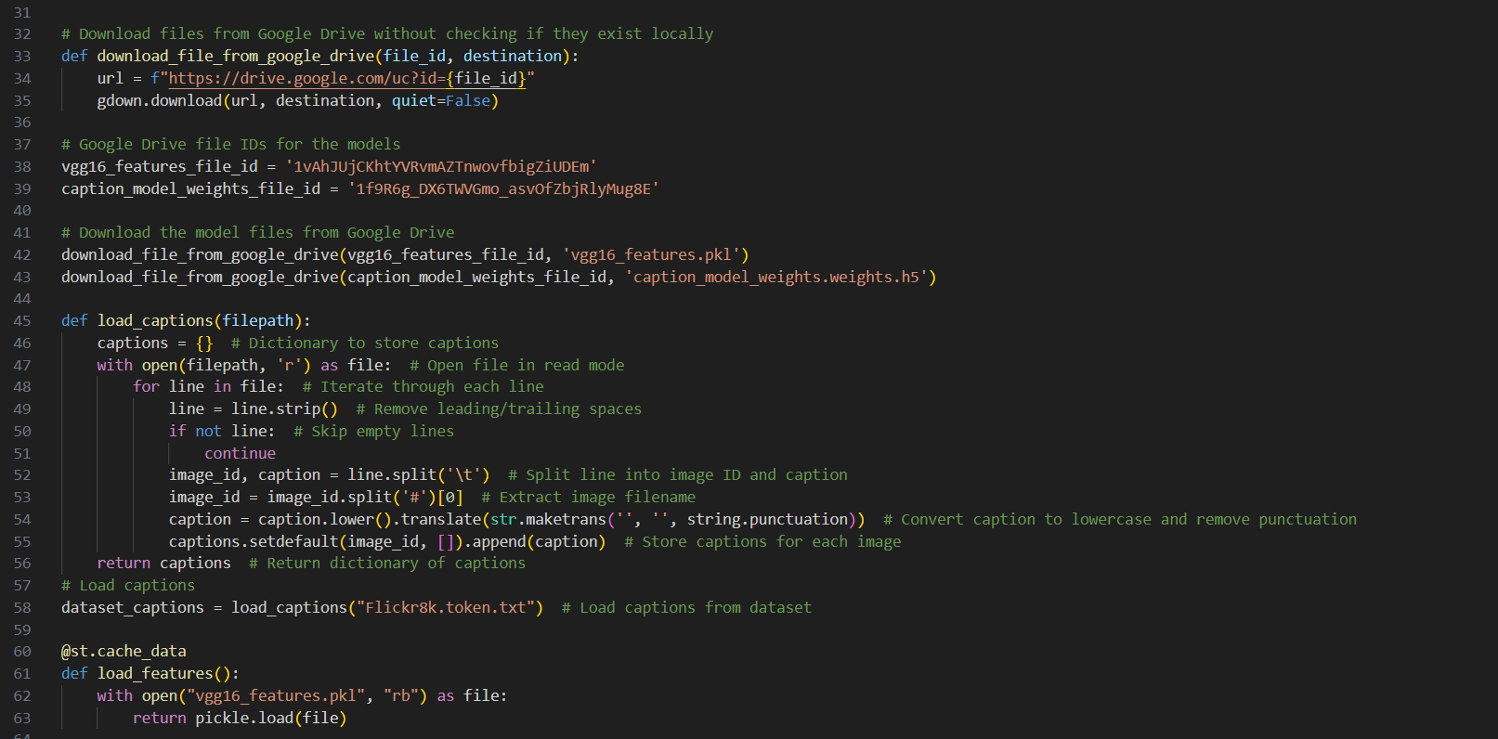

Slide 28
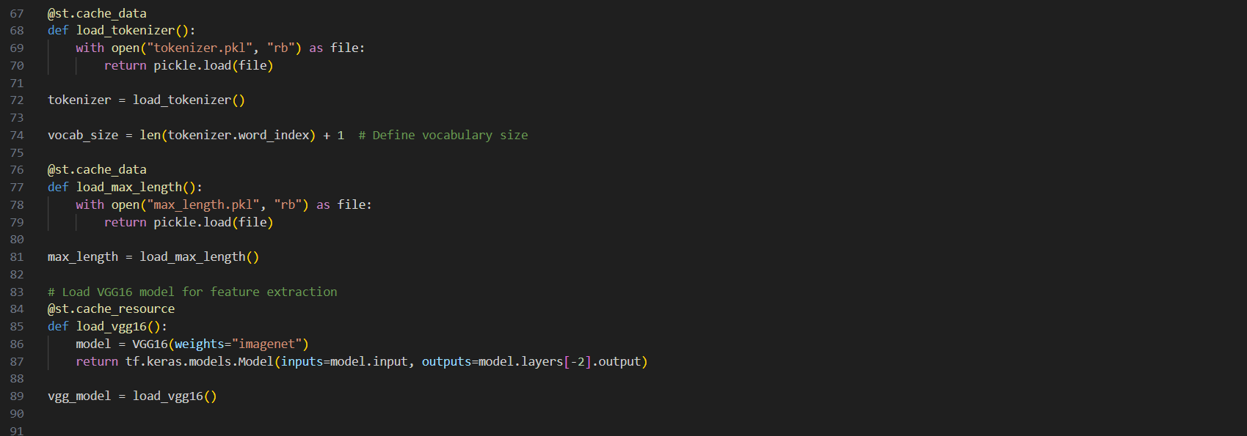

Slide 29
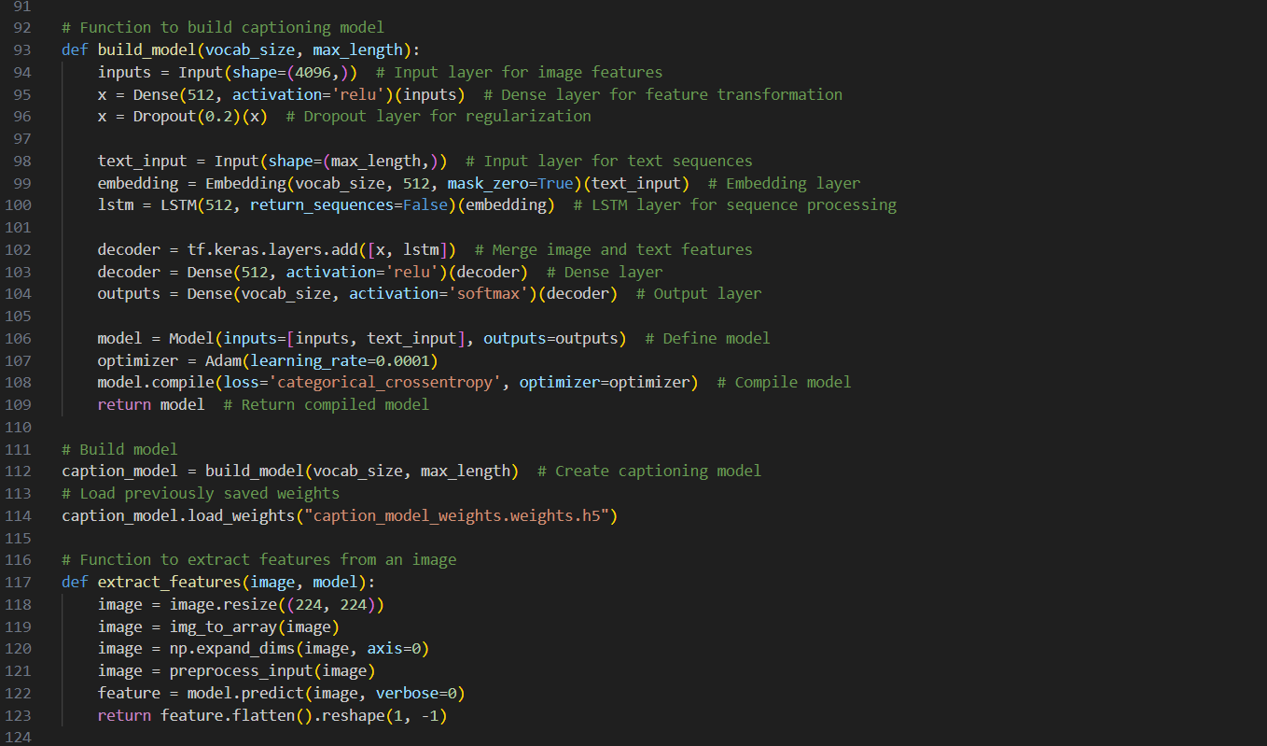

Slide 30
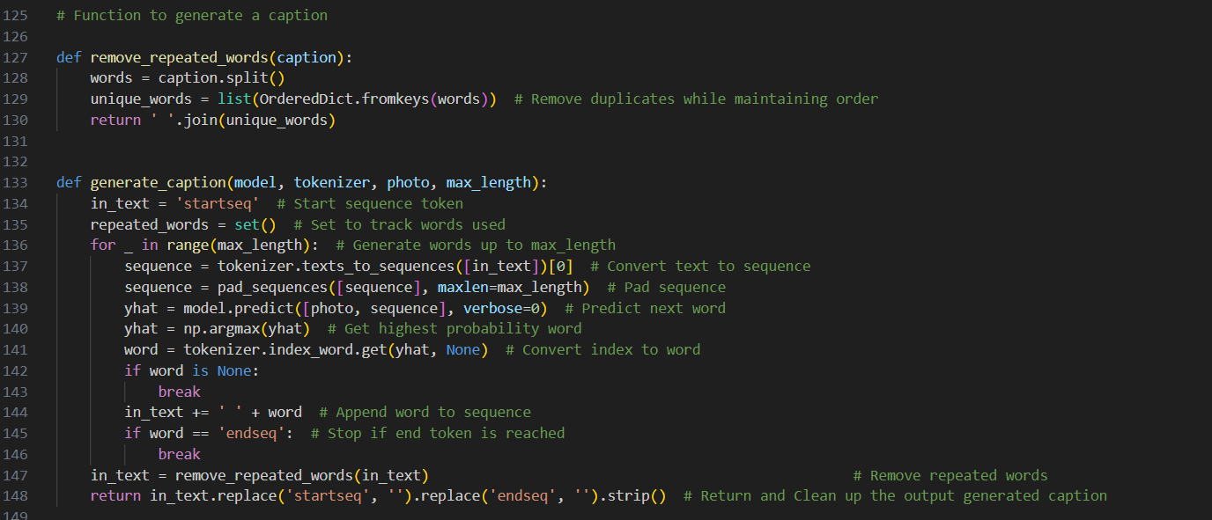

Slide 31
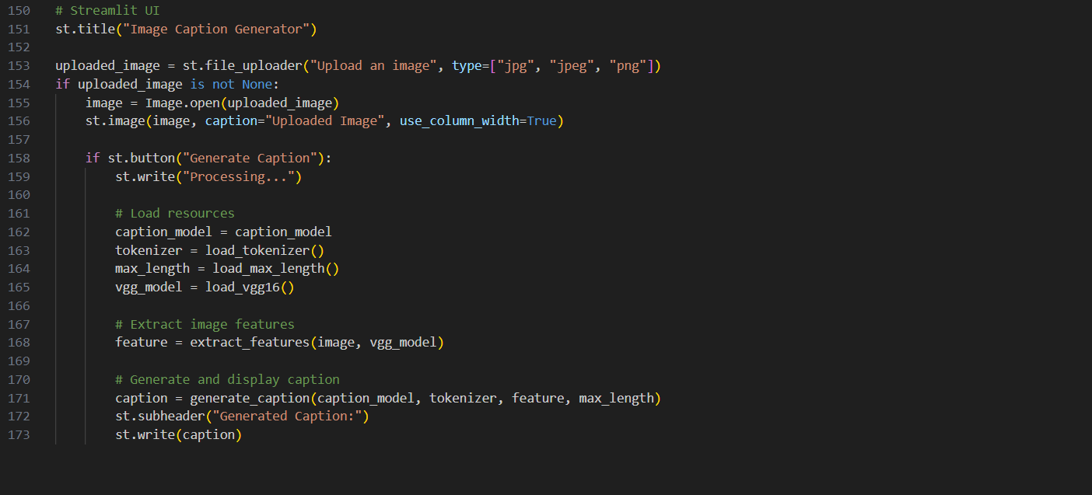

Slide 32
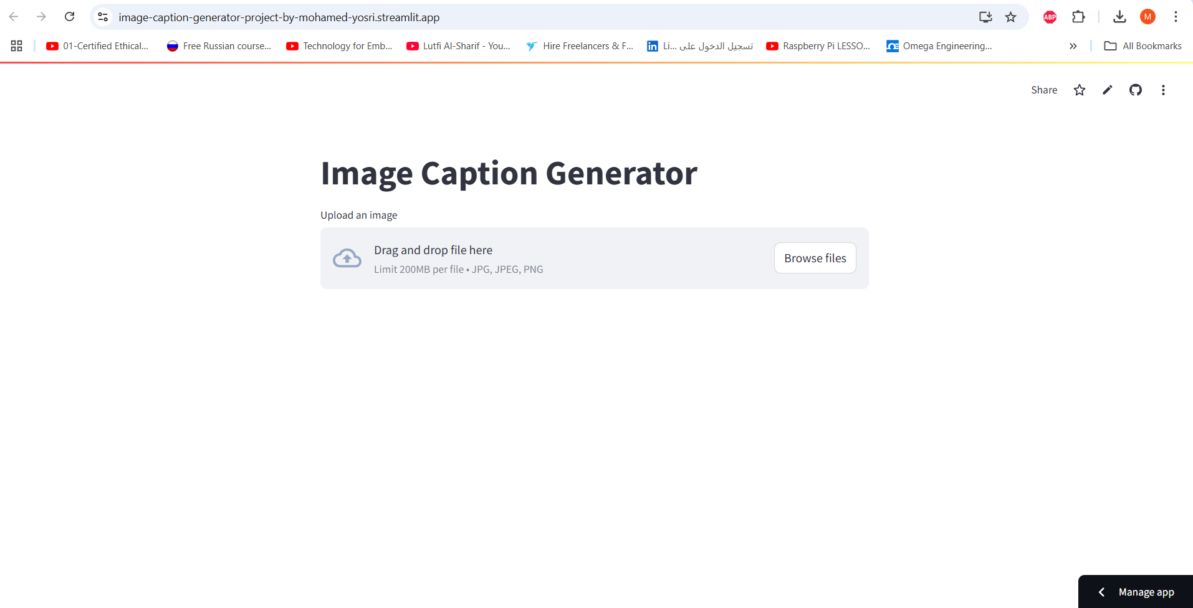
Final Product

Slide 33
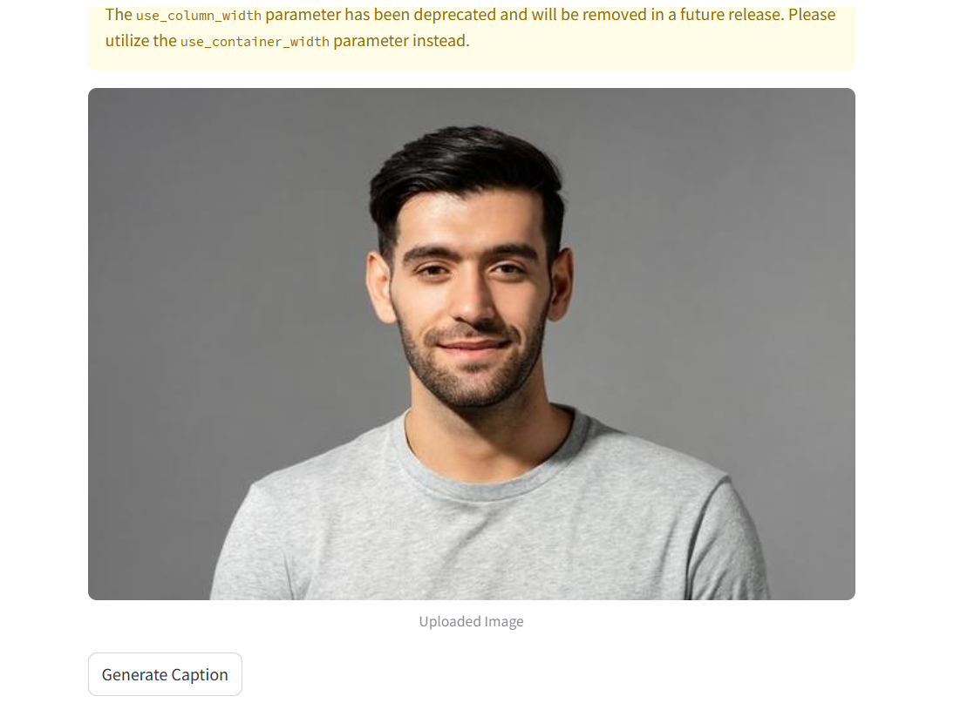
Final Product

Slide 34
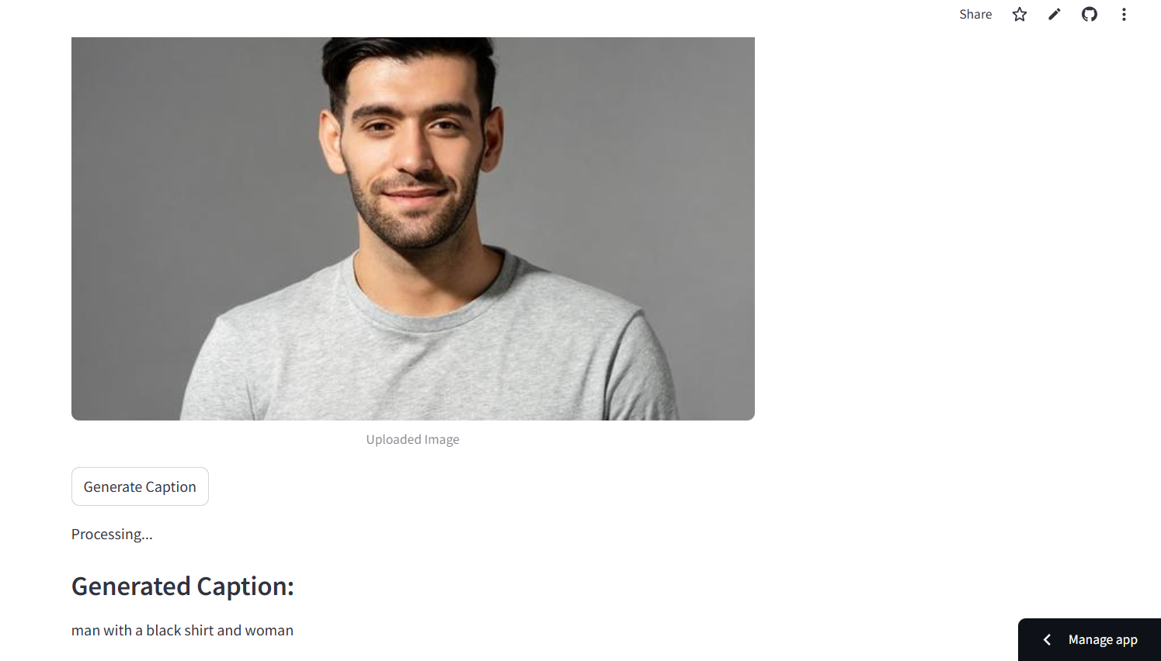
Final Product

Slide 35
The model accuracy isn’t the best accuracy but i was restricted by the runtime and ram consumption on my personal pc (that’s why I was training the model with only 2 epochs). Moreover, the code doesn’t end execution on colab before the daily quota have been reached.
Conclusion

Slide 36
Thank You

